Slide 1
UNIT-06 INPUT AND OUTPUT ,FILE SYSTEM
FILE SYSTEM
Files:-
A file is a collection of similar records. File is treated as a single entity by users and applications and may be referred by name.
Files have unique file names and may created and deleted. Restrictions on access control usually apply at the file level.
A file is a container for a collection of information.
The file manager provides protection mechanism to allow users administer how processes executing on behalf of different users can access the information in a file.
File protection is a fundamental property of files because it allows different people to store their information on a shared computer

Slide 2
File represents programs and data. Data files may be numeric, alphabetic binary or alphanumeric. Files may be free form ,such as text files. In general, file is sequence of bits ,bytes ,lines or records.
A file has a certain defined structure according to its type.
Text file.: Is a sequence of character organized into lines
Source file: Is a sequence of subroutines and functions.
Executable file: Is a series of code sections that the loader can bring into memory and execute.
Object file.: Is a sequence of bytes organized into blocks understandable by the system linker.
The file system permits users to create data collections, called files, with desirable properties.
Long term existence 2. Sharable between process 3. Structure

Slide 3
FILE ATTRIBUTES
File attributes vary from one operating system to another. Common file attributes are
Name : The symbolic file name is the only information kept in human readable form.
Identifier: Is the unique tag which identifies the file within the file system. It is usually a number. Some system supports different type of file.
Type: This information is required in this system.
Location: This information is a pointer to a device and to the location of the file on that device.
Size: It includes the maximum allowed size and current size of the file.
Protection: Is the fundamental property of the file.
Time, date and user identification.: This information is kept for creation, last modification and last use. Is useful for protection, security and usage monitoring

Slide 4
Access control information determines who can do reading, writing ,executing and so on.
All information about file is kept in the directory structure. It is stored on the secondary storage device.
File operations:
Create a file.
Writing a file
Reading a file.
Delete a file
Truncating
Repositioning within a file

Slide 5
CREATE A FILE: For creating a file, address space in the file system is required. After creating a file, entry of the file is made in the directory. The directory entry records the name of the file and the location in the file system.
WRITING A FILE: System call is used for writing into a file. It is required to specify the name of the file and information to be written to the file. Accordingly to the file name, system will search the name in the directory to find the location of the file.
READING A FILE: To read a file, system call is used. It requires the name of file and memory address. Again the directory is searched for the associated directory entry and the system needs to keep a read pointer to the location in the file where the next read is to take place.

Slide 6
DELETE A FILE: System will search the directory, which file to be deleted. If directory is found, it releases all file space. That free space can be reused by another (user) files.
TURNCATING A FILE: User may want to erase the contents of file but keep its attributes. Rather than forcing the user the user to delete a file and then recreate it, truncation function allows all attributes to remain unchanged except for the file length.
REPOSITIONING WITHIH A FILE: The directory is searched for the appropriate entry and the current file position is set to a given value. Repositioning within a file does not need to involve any actual I/O. This file operation is also known as file seek.

Slide 7
FILE TYPES
A Common technique for implementing file types is to include the type as part of
the file name. The name is split into parts: a name and an extension.
File type | Usual Extension | Functions
Executable | exe, com, bin or none | Read to run machine language program
Object | obj, o | Compiled, machine language not linked
Source code | c, cc, java, pas, asm, a | Source code in various language
batch | bat , sh | Commands to the command interpreter
text | bat ,doc | Textual data , documents.
Word processor | wp ,tex, rrf,doc | Various word-processor formats
library | lib , a , so , dil ,mpeg ,mov | Libraries of routines for programmers
Print/view | arc, zip ,tar | ASCII or binary file in a format for printing or viewing
archiev | arc , xip , tar | Related file grouped into one file.
Multimedia | mpeg,mov,rm | Binary file containing audio A/V information

Slide 8
FILE STRUCTURE
File structure uses the following four terms:
Field:
Field is the basic element of data.
An individual field contains a single value. E.g. last name, date. Field is characterized by its length and data type.
Depending on the file design, fields may be fixed length or variable length.
Record:
A record is collection of related fields that can be treated as a unit by some application program.
Record may be variable length or fixed length.
E. g. student record Name ,PIN, Roll No.

Slide 9
FILE STRUCTURE
File:
A file is a collection of similar records.
The file is treated as a single entity by users and applications and may be referenced by name.
Database:
A database is a collection of related data.
A database may contain all the information related to an organization or project.
The database itself consists of one or more types of files

Slide 10
FILE MANAGEMENT SYSTEM
Objective:
To meet the data management needs and requirements of the user.
To provide I/O support for a variety of types of storage device.
To provide a standardized set of I/O interface routines.
To minimize or eliminate the potential for lost or destroyed data.
To guarantee that the data in the files are valid.
Requirements:
Each user should be able to create, delete, read , write and modify files.
Each user may have controlled access to other user’s files.
Each user should be able to back up and recover the user’s files in case of damage.
Each user may control what types of access are allowed to the user’s files.

Slide 11
FILE SYSTEM ARCHITECTURE
User program
Pile Sequential Indexed sequential Indexed hashed
Logical I/O
Basic I/O supervisor
Basic File System
Disk Tape device
Device driver driver
File System Software architecture

Slide 12
Device Driver:
Bottom layer i.e. device drivers communicate directly with peripheral devices or their controllers or channels.
A device driver is responsible for starting I/O operations on a device and processing the completion of an I/O request
Device drivers are usually considered to be part of the operating system.
Basic File System:
This layer also called physical I/O level. It is the primary interface with the environment outside of the computer system.
It deals with the blocks of data that are exchanged with disk or tape systems.
It does not understand the content of the data or the structure of the file involved.
Basic file system is often considered part of the operating system.

Slide 13
Basic I/O supervisor:
This layer is responsible for all the I/O initiation and termination. Control structures are maintained at this level and deal with device I/O, scheduling and file status.
This layer selects the device on which the file I/O is to be performed, based on the particular file selected. It also perform the allocation of secondary memory.
The basic I/O supervisor is part of the operating system.
Logical I/O:
Logical I/O enables users and applications to access records. It deals with file records.
It provides a general purpose record I/O capability and maintains basic idea about files.

Slide 14
ACCESS METHODS( File Organization)
A file is a collection of records where each record consists of one or more fields. File organization can be defined as the method of storing data records in a file.
The primary objective of the organization is to provide means for record retrieval and update. The factors involved in selecting a particular file organization are :
Economy of storage.
Ease of retrieval.
Convenience of update.
Reliability.
Security
Integrity.
Volume of transaction.

Slide 15
COMMONLY USED FILE ORGANIZATION
File Organization
Pile
Sequential File
Index
Sequential File
Indexed
File
Direct or Hashed
File

Slide 16
THE PILE
The Pile is the simplest form of file organization.
Data are stored in the order they arrive.
A Pile is used to accumulate the mass of data and save it.
In a Pile, records may have different fields, or similar fields in different order.
There is no structure to the pile. Searching a record requires exhaustive search. To search a record, it is necessary to search record until desired record is found.
Pile files are used where it may not be possible to organize data.
Pile files uses less space when the stored data vary in size and structure.

Slide 17
Variable length record, variable set of fields
Chorological order of storing

Slide 18
SEQUENTIAL FILE
It is the most common type of file. In this type of file:
A fixed format is used for record.
All records are of the same length.
Position of each field in record and length of field is fixed.
Records are physically ordered on the value of field is fixed.
Records are physically ordered on the value of one of the fields-called the ordering field.
NAME | ROLL NO | YEAR | BRANCH
SINHA R. | 1000 | 1 | 60.89
SINGH M. | 1010 | 2 | 53.76
PATHAK A. | 1012 | 1 | 80.98
SATHE V. | 1015 | 3 | 65.4

Slide 19
ADVANTAGES
Reading of records in order of the ordering key is extremely efficient.
Finding the next record in order of the ordering key usually does not require additional block access. Next record may be found in the same block.
Searching operation on ordering key is must faster. Binary search can be utilized.
A binary search will require lig₂b where b is total number of blocks in the file.

Slide 20
DISADVANTAGES
Sequential file does not give any advantage when the search operation is to be carried out on non-ordering field.
Inserting a record is an expensive operation. Insertion of a new record requires finding of place of insertion and then all records ahead of it must be moved to create space for the record to be inserted.
Deleting a file is an expensive operation. It also requires movement of records.
Modification of field value of ordering key could be time consuming.
Modifying the ordering field means the record can change its position. This requires deletion of the old record followed by insertion of the modified record.

Slide 21
INDEXED FILE
Indexing is used to speed up retrieval of records. It is done with the help of a separate sequential file.
Each record in the index consist of two fields, a key field and a pointer to the main file.
To find a specific record for the given key value, index is searched for the given key value.
Binary search can be used to search in index file.
After getting the address of record from index file, the record in main file can easily be retrieved.
Index file is ordered on the ordering key roll no. Each record of index file points to the corresponding record. Main file is not sorted.

Slide 22
Last
Name
Key
Pointer
NAME | ROLL NO | YEAR | %
SINHA R. | 1016 | 1 | 60.89
SINGH M. | 1010 | 2 | 53.76
PATHAK A. | 1000 | 1 | 80.98
SATHE V. | 1015 | 3 | 65.4
1000
1010
1015
1016
Index File
Main File

Slide 23
Search
Key
Pointer
NAME | ROLL NO | YEAR | %
SINHA R. | 1016 | 1 | 60.89
SINGH M. | 1010 | 2 | 53.76
PATHAK A. | 1000 | 1 | 80.98
SATHE V. | 1015 | 3 | 65.4
1000
1010
1015
1016
Index File
Main File

Slide 24
ADVANTAGES
Sequential file can be searched effectively on ordering key.
When it is necessary to search for a record on the basis of some other attribute than the ordering key field, sequential file representation is inadequate.
Multiple indexes can be maintained for each type of field to be used for searching.
Hence indexing involves much better flexibility.
With indexing new records can be added at the end of the main file . It will not require movement of records as in the case of sequential file. Udaption of index file requires fewer block accesses compare to sequential file.
An index usually requires less storage space than the main file. A binary search on sequential file will require accessing of more blocks.

Slide 25
Consider an example of a sequential file with
r = 1024 records of fixed length
record size R = 128 bytes stored on the disk with
block size B = 2048 bytes.
Number of blocks required to stored the file = 1024 * 128 = 64
2048
Number of blocks accesses for searching a record =log₂⁶⁴ = 6
Suppose an index needs to be constructed on a key field V =4 bytes long and the block pointer is P = 4 bytes long. A record of an index file is of the form <Vi , Pi> and it will need 8 bytes per entry.
Total Number of index entries = 1024
Number of blocks needed for the index is bi = 1024*8/2048 = 4 blocks.
Binary search on the index will require = log₂⁴ = 2 block access

Slide 26
HASHED (DIRECT) FILE ORGANIZATION
It is common technique used for fast accessing of records on secondary storage.
Records of a file are devided among buckets.
A bucket is either one disk block or clusture of contiguous blocks.
A hashing function maps a key into a bucket number.
A buckets are numbered 0,1,2……….b-1.
A hash function f maps a key into one of the integers through b-1
If x is a key f(x) is the number of bucket that contains the record with key x.
The block making up each bucket could either be contiguous block or they can be chained together in a linked list.

Slide 27
Translation of bucket number to disk block address is done with the help of bucket directory.
It gives the address of the first block of the chained blocks in a linked list.
Hashing is quite efficient in retrieving a record on hashed key.
The average number of block accesses for retrieving a record
= 1(bucket directory)+ No of records/(no of buckets * no of records per bock)
Thus the operation is b times faster ( b = number of buckets) than unordered file.
To insert a record with key value x, the new record can added to the last block in the chain for bucket f(x). If the record does not fit into the existing block, record is stored in a new block and this new block is added at the end of the chain for bucket f(x).
A well designed hashed structure requires two block accesses for most operations.

Slide 28
Bucket 0
Bucket Directory
230
460
580
480
790
810
0
1
2
3
B-1
232
242
262
272
382
392
Bucket 1
562
672
982
Hashing with buckets of chained blocks

Slide 29
INDEXED SEQUENTIAL FILE
Roll No
Block Ptr.
101
150
101
201
351
Primary index on the ordering
Key field roll number
201
230
805
905
805
889
905
989
Index File

Slide 30
INDEXED SEQUENTIAL FIEL
An indexed sequential file is characterized by
Sequential organization (ordered on primary key)
Indexed on primary key.
An indexed sequential file is both ordered and indexed.
Records are organized in sequence based on a key field, known as primary key.
An index to the file is added to support random access.
Each record in the index file consists of two fields: a key field which is same as the key field in the main file.
Number of records in the index file is equal to the number of blocks in the main file (data file) and not equal to the number of records in the main file( data file)
Total number of entries in index is same as the number of disk blocks in the ordered data file.

Slide 31
FILE SYSTEM IMPLEMENTATION
An important function of the file system is to manage on the secondary storage, which includes keeping track of both disk blocks allocated to files and the free blocks available for allocation.
The main problem in allocating space to files are;
Effective utilization of disk space.
Fast accessing of files.
Management of disk block is similar to memory management, But secondary storage introduces 2 problems:
Slow disk access time.
Large number of blocks to deal with.

Slide 32
FILE SYSTEM IMPLEMENTATION
There are three widely used techniques for allocation of disk blocks to a file:
Contiguous allocation.
Linked allocation.
Indexed allocation.
While studying allocation strategies file is consider as a sequence of blocks.
All I/O operations on disk occurs in terms of blocks.
The conversion from logical records to physical blocks is done by software

Slide 33
CONTIGUOUS ALLOCATION
Files are assigned to contiguous area of secondary storage.
In contiguous allocation, user specifies in advance the size of the area needed to hold a file before creation.
If the desired amount of contiguous space is not available the file cannot be created.
FILE START SIZE (IN BLOCKS)
F1 1 4
F2 8 7
F3 16 4
F4 21 3
DIRECTORY
0
1
2
3
4
5
6
7
8
9
10
11
12
13
14
15
16
17
18
19
20
21
22
23

Slide 34
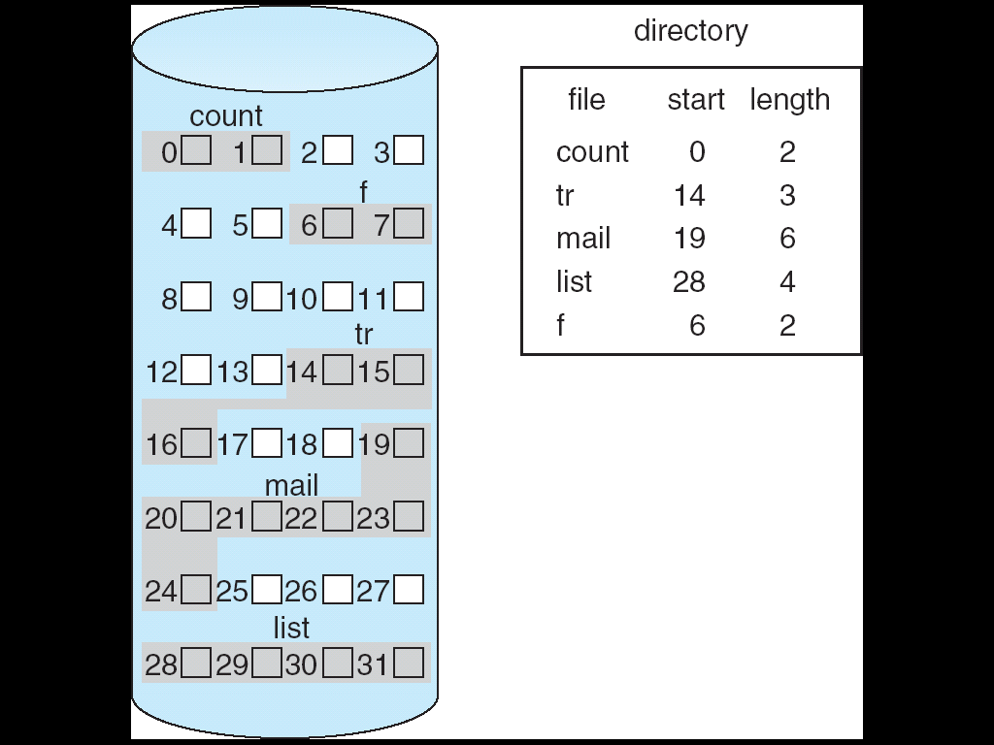
CONTIGUOUS ALLOCATION

Slide 35
ADVANTAGES
This scheme is fairly simple.
Successive records of a file are normally adjacent to each other. This increases the accessing speed of records.
This allocation supports both sequential and direct accessing of file.
For direct access to block B of a file that starts at location L, the block L+B can be immediately accessed.
The file directories in this allocation system are relatively straight forward to implement.
For each file it is necessary to retain the starting address of the file and the file’s size.

Slide 36
DISADVANTAGES
External fragmentation.
To satisfy a request of a file of n free contiguous blocks, set of unused blocks are searched to determined which hole is best suited for allocation.
Two common strategies are:
First-Fit
Best-Fit.
These algorithms are suffer from external fragmentation.
All files are allocated and deleted the free disk space is broken into little pieces.
The major problem with contiguous allocation is how to find the space needed for allocation.

Slide 37
LINKED ALLOCATION
Files tend to grow and shrink dynamically.
It is very difficult for users to know in advance the size of file.
Contiguous allocation systems are being replaced by more dynamic non-contiguous storage allocation system.
Linked allocation is essentially a disk based version of linked list.
In a linked allocation, allocation list of blocks to a file is a linked list of blocks.
These blocks need not be contiguous.
Each block contains the address of next block.
There is a file of 6 blocks which start from block 8 and ends with disk block 18.

Slide 38
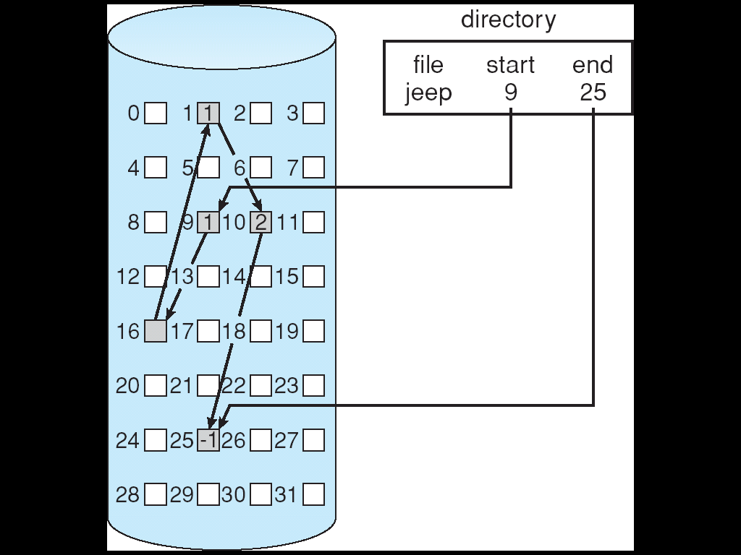

Slide 39
LINKED ALLOCATION
Directory
File Start End
F1 8 18
0
1
2
3
4
5
6
7
8
9
10
11
12
13
14
15
16
17
18
19
20
21
22
23

Slide 40
ADVANTAGES
Simple to implement.
Disk compaction is required.
There is no problem of external fragmentation.
The file size grow or shrink dynamically.
Because of noncontiguous nature of allocation, the linking does not produce any external fragmentation.
Any disk block on the free space can be used to satisfy a request, since all blocks are linked together. There is also no need of declaration of the size of a file in linked allocation while it is created.

Slide 41
DISADVANTAGES
Slow accessing of a record-to find out a record it must start at the beginning of the file and follow the pointer until the block containing a particular record if found.
There is wastage of space for storing block pointers.
There is a problem of reliability –A single damaged pointer can make thousands of disk blocks inaccessible.
INDEXED ALLOCATION
One disadvantage of linked allocation method is that it does not support direct accessing as allocated blocks are linked together.
This problem is solved by indexed allocation by placing all of the pointers together into an index block.

Slide 42
INDEXED ALLOCATION
In this scheme, each file is provided with an index block. The index block for file f1 is block no.3
An index block contains an array of disk blocks allocated to the said file. Following blocks are allocated to the file f1: 6,8,13,21
Directory
File Index Block
F1 3
0
1
2
3
4
5
6
7
8
9
10
11
12
13
14
15
16
17
18
19
20
21
22
23
Disk
Blocks

Slide 43
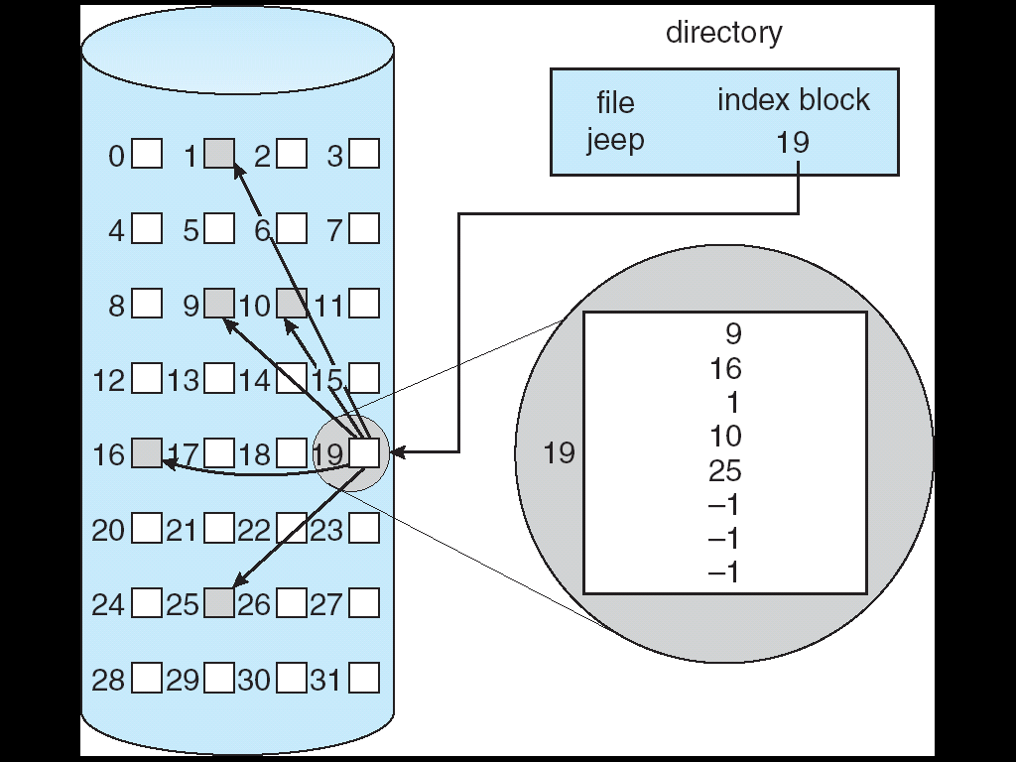
Address of index block
Arry of disk block addresses

Slide 44
MULTI-LEVEL INDEXING
A single –level indexing may not be able to store a large file.
Suppose disk blocks are of size 512 bytes and are allocated to pointers.
All index blocks can contain maximum of 512/4= 128 pointers to disk blocks.
The target file in such a system cannot exceed 128 blocks of 512 bytes each.
This problem can be solved by multiple level indexing.
Directories contains the address of the first level index.
First level index block contain the addresses of data block.
This approach could be continued to multiple levels. A two level indexing is capable of addressing a file size upto 128*128*512=8MB.

Slide 45
ADVANTAGES
There is no external fragmentation.
It has the efficiency of random accessing.
File size can grow or shrink dynamically.
DISADVANTAGES The primary disadvantage of indexing is additional disk accesses to retrieve the address of the data block. Index allocation requires lots of space for keeping pointers.

Slide 46
TWO LEVEL INDEXING
Directory
File Index
F3 block
First Level
index block
Index
Second Level
index block
Index
Index
Index
Data
Data
Data
Data
Data
Data
Data Blocks

Slide 47
DISK SPACE MANAGEMENT
Linked List.
Bit Map.

Slide 48
IMPLEMENTING DIRECTORIES(FILE SYSTEM)
1 8 3 1 2 16
File Name
User Code
File Type
(Extension)
Extent
Block Count
Disk Block numbers
A directory entry in CP/M

Slide 49
8 3 1 10 2 2 2 4
File Name Size
Extension Attributes
First
Block Number
Time
date
The MS-DOS directory Entry

Slide 50
Technique for performing I/O
In most of the data processing activities, a program has to accept input from the keyboard, or from a file stored in secondary storage device.
Processed data is presented in the form of output.
Input/output activities involve interaction with input/output devices.
Input/output operation refers to a data transfer between an input/output device and main memory, or between an input/output device and CPU.
User program never interact directly with input/output devices.
All input/output operations are performed with the help of system calls.
Whenever a system call is made, CPU executes a small memory resident program known as device driver or interrupt service routine

Slide 51
These specialized routines interact with an input/output device with the help of input/output commands. There are 4 types of input/output commands.
Control.
Test status.
Read.
Write.
Each peripheral requires some specific controls.
Head of hard disk may be moved backward or forward. A magnetic tape unit may be instructed to rewind.
CPU may need to test the status of a device to confirm whether a device is switched on.
Before writing the next data, it may necessary to check whether the previous data has been accepted and consumed by the input/output device. processor can accept data from an input/output device through read command.

Slide 52
Similarly the processor can transmit the data items to peripheral through a write command.
A CPU is a general purpose processor. It is capable of addressing all needs of an input/output device.
If data transfer operations are completely controlled by the CPU, that is the CPU executes a program that initiates, directs and terminates input/output operation.
This can be implemented without any additional hardware.
But input/output devices are very slow, CPU will be wasting a lot of its time in trival Input/output operations.
Another technique, that can considerably improve CPU performance is known as interrupt driven Input/output.
In interrupt driven technique ,the CPU issue the input/output device and starts executing other programs.
When the Input/Output operation in complete , input/output device interrupts CPU by informing the CPU that I/O is finished

Slide 53
CPU then may proceed with execution of original program.
In Input/output mode, CPU can handle several Input/Output activities in parallel.
In both programmed and interrupt driven Input/Output CPU is responsible for either sending or receiving of data.
A slight increase in hardware enables an Input/Output device to transfer a block of data to and from memory without intervention of CPU. This mode of intervention of is known as DMA (Direct memory Access). Thus there are 3 commonly used Input/Output techniques (data transfer mode):
Programmed Input/output.
Interrupt driven Input/Output .
Direct memory Access.

Slide 54
PROGRAMMED I/O
Programmed I/O is a useful method for computers where hardware costs need to be minimized.
Entire Input/output is handled by CPU with the help of a small software without any additional hardware.
It is based on the concept of busy waiting. Before Input/Output operation is performed, CPU checks the status of the input/output device.
If the device is not ready, CPU simply waits in a loop for the input/output device to become.
CPU performs the following steps.
Read the Input/output device’s status bit.
Test the status bit to determine if the device is ready to begin data transfer operation.
If the device is not ready, return to step 1; otherwise proceed with the data transfer. During the interval, device is not ready, CPU simply wastes its time until the device becomes ready.

Slide 55
CPU issues a read or write
Command to I/O device
CPU----→ I/O
Read status of
I/O device
I/O----→ CPU
Transferring a block of data using
programmed Input/output
Status
Not Ready
CPU reads a word from I/O device
And write it to memory or writes a word
To I/O device after reading it from memory
Memory----→ CPU-→ I/O OR
I/O-→ CPU→ Memory
Is bloc k
Transfer is
complete
NO
Yes
Execute next Instruction

Slide 56
INPUT/OTPUT ADDRESSING
DATA BUS
ADDRESS BUS
READ LINE
WRITE LINE
MAIN
MEMORY
CPU
I/O MODULE1
I/O MODULE2
Structure of memory mapped input/output
READ: Command is for input of data.
WRITE: Command is for output of data.
I/O module is used for interfacing of a device with .system bus
When the processor ,main memory and input/output share a common bus
Two modes of addressing are
Memory mapped I/O
Input/output-mapped I/O.

Slide 57
MEMORY MAPPED I/O
General structure of memory mapped I/O is as shown above.
With memory mapped I/O Input/Output, there is a single address space for memory locations and input/output devices.
Processor treats status and data registers as separate memory locations. Status and data registers are part of an I/O devices.
Processor uses same memory instructions to access both memory and input/output devices.
With memory-mapped Input/Output, a single read line and a single write line are needed on the bus.
READ line is activated during transfer of data from memory to CPU.
E.g. MOV AX, x [AX ← x]
8086,assembly instruction ‘MOV AX’ will transfer a word of data from memory location x into CPU register AX. This activates READ line
WRITE line is activated during transfer of data from CPU to memory.

Slide 58
Example:
MOV x AX [x← AX]
With memory mapped I/O, no special commands (IN,OUT) are needed for input/output operations.
Powerful addressing modes, available for accessing memory variables can also be used to address an input/output.
A large set of instructions (meant for memory operands) can be used for input/output. This allows more efficient programming.
Interfacing circuit for memory-mapped Input/Output is complex. Device has to behave like a set of memory locations to CPU

Slide 59
I/O-mapped I/O
Data Bus
Address Bus
Memory Read
Memory Write
I/O Read
I/O Write
Main
Memory
CPU
I/O
Module 1
I/O
Module 2
Structure of I/O-mapped I/O

Slide 60
There are separate control lines for memory and Input/output devices.
A memory reference instruction does not effect an Input/output device.
There are separate address spaces for memory and Input/output devices.
An input/output device and a memory location can have same address.
There are separate instructions for Input/output read and Input/output write.
A memory reference instruction for memory read will cause generation of ‘Memory READ’ control signal.
MOV AX, x [AX← x]
A memory reference instruction for memory write will cause generation of ‘Memory WRITE’ control signal

Slide 61
MOV x, AX [x← AX]
An input/Output reference instruction for Input/output read will cause generation of ‘Input/output READ control signal.
IN AL, 300H (AL ← data from port with address 300H)
An Input/output reference instruction for Input/output write will cause generation of ‘Input output WRITE’ control signal.
OUT 300H,AL ( Content of AL register is written to port with address 300H)

Slide 62
INTERRUPT DRIVEN I/O
Major drawback of programmed Input/Output is busy waiting.
The speed of Input/Output device is much slower in comparison to that of CPU.
Since in programmed input/output, CPU has to repeatedly check whether a device is free, the performance of CPU goes down. One solution could be:
CPU switches to some other program without waiting for the input/Output device to complete or to become free.
When the device free, it informs back the CPU through a mechanism, known as interrupt.
The interrupt driven Input/output mechanism for transferring a block of data is as shown below.

Slide 63
Start
CPU issues a read or write
Command to I/O device
CPU----→ I/O
I/O module informs about
Its status by interrupting the CPU
I/O----→ CPU
Not Ready
Transferring a block of data using
Interrupt driven Input/output
Status
?
Error
Ready
CPU reads a word from memory
And write it to I/O device or CPU reads a word
from I/O device write it in memory
Memory----→ CPU-→ I/O OR
I/O-→ CPU→ Memory
Is bloc k
Transfer is
Complete
?
NO
Yes
Execute next Instruction

Slide 64
SUBROUTINE VS. INTERRUPT SERVICE ROUTINE
SUBROUTINE | INTERRUPT ROUTINE
1.These are written to modularly structure a big program. | 1.These are executed in response to an interrupt request.
2.A call to a subroutine is executed, the current program counter value is saved on top of the stack and the address of the subroutine is loaded in program counter. After execution the return address is popped up in program counter. | 2.When interrupt comes , the processor first completes execution of current instruction. Then it loads the program counter with the address of the first instruction of the interrupt-handler-program. Return address is pushed on the top of stack.
3.Subroutines performs a function required by the program from which it is called. | 3.It may have nothing in common with the program being executed at the time the interrupt request is received.
4.The process saves only the contents of program counter. Any additional information to be saved must be saved by program instruction at the beginning of subroutine and restored at the end. | 4.The processor saves only the content of program counter and the processor status register when an interrupt is generated.

Slide 65
INTERRUPT PROCESSING
CPU receives
An interrupt
Begin ( suspend execution of current program)
Steps taken by
Interrupt H/W
CPU identifies the
Source of interrupt
Save contents of other CPU
Register onto STCAK
Steps taken by
Interrupt handler.
CPU obtains the address
Of required interrupt
Handler program
Process interrupt, that
Provide the required service
Restore
CPU registers
From STACK
Processor
PSW and PC onto
Control stack
Restore old
PSW and PC
From stack
Processor load PC
With addr. Of interrupt
handler
Resume Execution
Of interrupted prog.

Slide 66
INTERRUPT TYPES
Various types of interrupts whose sources may be internal or external are:
Program Interrupts ( S/W interrupts): Are generated by some condition that occurs as a result of an instruction execution such as
Arithmetic overflow.
Division by zero.
Execution of an illegal machine instruction.
Segment limit violation.
Execution of privileged instruction.
Timer interrupts.: Are generated within the processor. This allows the O.S. to perform certain operation's on regular basis
Input/Output interrupts.: Are generated for initiation or completion of input/output failure or input/output error too can generate an interrupt.
Hardware failure interrupts.: Are generated by a failure, such as power failure or memory parity error

Slide 67
DIRECT MEMORY ACCESS (DMA)
Data
Count
It control the flow of bits between memory
And some other controller without constant
CPU intervention.
The CPU sets up the DMA chip telling how
Many bytes to transfer the device and memory
Add and the direction and lets it go.
Data Lines
Data
Register
Address
Register
Address Lines
DMA Block Diagram
DMS request
Control
Logic
DMS ACK
Interrupt
Read
Write

Slide 68
No matter if a CPU does or does not have memory mapped I/O, it needs to address the device controllers to exchange data with them.
The CPU can request data from an I/O controller one byte at a time but doing so wastes the CPU’s time so a different scheme. Called DMA is used.
OS can only use DMA if the hardware has a DMA controller.
Sometimes it is integrated with disk but it requires separate DMA for each device.
DMA controller is available on the parent board for regulating transfer to multiple devices often concurrently.
It contains several registers can be read or write by CPU, memory address registers, a byte count register and one or more control registers which specify the I/O port to use the direction of the transfer unit and number of bytes to transfer in one burst.

Slide 69
Time
Processor Processor Processor Processor Processor Processor
cycle cycle cycle cycle cycle cycle
Fetch Decode Fetch Execute Store Process
Instruction Instruction Operand Instruction Result Inerrupt
Instruction Cycle
Interrupt breakpoints
DMA Breakpoints
DMA and interrupt breakpoints during an instruction cycle.

Slide 70
DMA
Controller
Disc
Unit
High
Speed Printer
BUS
CPU
Main
Memory
A two channel DMA controller

Slide 71
DMA is programmed I/O, only with DMA controller is doing all the work instead of CPU.
It requires special hardware (DMA controller) but frees up CPU during I/O to do the other work.
This is to reduce the number of interrupts.
The DMA controller is slower than the main CPU.
If the DMA controller is not capable of driving the device at full speed, or the CPU usually has nothing to do anyway while waiting for the DMA interrupt, then DMA interrupt-driven I/O or even programmed I/O may be better.

Slide 72
POWER MANAGEMENT IN COMPUTER
Introduction.
Hardware Issues
Operating system issues.
The Display.
The Hard Disk.
The CPU.
The memory.
Thermal Management.
Battery management.
Driver Interface.
Application Program Issues.

Slide 73
INTRODUCTION
The first general purpose computer the ENIAC had 18,000 vaccum tubes and consumed 140,000 watts of power.
After the invention of the transistor, power usage dropped dramatically and the computer industry lost in power management.
But the power management is in the spotlight for several reasons, and OS plays an important role.
Desktop PCs has a 200-watt power supply ( which is typically 85% efficient, that is, loses 15% of the incoming energy to heat).
The other place where power is a big issue is on battery-powered computers, including notebooks, handhelds and web pads , among others.
The heart of the problem is that the batteries cannot hold enough charges to last long.( a few hours at most)
So making computers use less energy so existing batteries last longer is high on everyone’s agenda.

Slide 74
INTRODUCTION
At the lowest level H/W vendors are trying to make their electronics more energy efficient .
Techniques used include reducing transistor size, employing dynamic voltage scaling.
There are two general approaches to reducing energy consumption.
For the O.S. to turn off parts off parts of the computer (mostly I/O devices)
For the application program to use less energy ,possibly degrading the quality of the user experience, in order to stretch out battery time.

Slide 75
HARDWARE ISSUES
Batteries come in two general types:
Disposable and
Rechargeable
Disposable batteries (mostly AAA ,AA and D cells) can be used to run handheld devices but do not have enough energy to power notebook computers with large bright screens.
A rechargeable battery , in contrast can store enough energy to power a notebook for a few hours.
Nickel cadmium batteries used to dominate but they gave way to nikel metal hydride batteries, which last longer and do not pollute the environment quite as badly when they are eventually discarded.
Lithium ion batteries are even better, and may be recharged without being fully drained but their capacities are also severely limited.

Slide 76
HARDWARE ISSUES
The general approach most computer vendors take to battery conservation is to design the CPU , memory , and I/O devices to have multiple states.
On
Sleeping
Hibernating
Off
To use the device, it must be on. When the device will not be needed for a short time, it can be put to sleep, which reduces energy consumption.
When it is not expected to be needed for a longer interval ,it can be made to hibernate, which reduces energy consumption even more.
The trade-off here is that getting a device out of hibernation often takes more time and energy than getting a device out of hibernation often takes more time and energy than getting out of sleep state.

Slide 77
HARDWARE ISSUES
Finally , when a device is off, it does nothing and consumes no power.
Not all devices have all these states , but when they do, it is up to the operating system to manage the state transitions at the right moments.
Some computers have two or even three power buttons.
In some countries, electrical devices must, by law, have a mechanical power switch that breaks a circuit and removes power from the device, for safety reasons.
To comply with this law, another switch may be needed.

Slide 78
OPERATING SYSTEM ISSUES
The OS plays a key role in energy management.
It controls all the devices, so it must decide what to shut down and when to shut down.
If it shut down a device and that device is needed again quickly, there may be an annoying delay while it is restarted.
On the other hand, if it waits too long to shut down a device energy is wasted for nothing.
The fact is to find algorithms and heuristics that let the OS make the OS good decisions about what to shut down and when.

Slide 79
DISPLAY
Is the biggest item in everyone’s energy budget is the display.
To get a bright sharp image, the screen must be backlit and that takes substantial energy.
Many OS attempt to save energy here by shutting down the display when there has been no activity for some number of minutes
Often the user can decide what the shutdown interval is, thus pushing the trade-off between frequent blanking of the screen and using the battery up quickly back to the user.
Turning off the display is a sleep state because it can be regenerated (from the video RAM) almost instantaneously when any key is struck or the pointing device is moved.

Slide 80
DISPLAY
Flinn and Satyanarayanan (2004) suggested one possible improvement having a display consist of some number of zones that can be independently powered up or down.
E.g 16 zones are depicted using dashed line to separate them, when the cursor is in window 2 only the four zones in the lower right-hand corner have to be lit up. The other ¾ of the screen power.
Window-1
Zone
Zone
Window-1
Window-2
Window-2

Slide 81
DISPLAY
When the user moves the cursor to window 1, the zones for window 2 can be darkened and the zones behind window 1 can be turned on.
However because window 1 straddles 9 zones, more power is needed.
If the window manager can sense that , it can automatically move window 1 to fit into 4 zones, which is a snap-to-zone action.

Slide 82
HARD DISK
Another major villain is the hard disk.
It takes substantial energy to keep it spinning at high speed, even if there are no accesses .
Many computers especially notebooks, spin the disk down after a certain number of seconds or minutes of inactivity and when it is next needed, it spin up again.

Slide 83
THE CPU
The CPU can also be managed to save energy.
A notebook CPU can be put to sleep in software, reducing power usage to almost zero.
The only thing it can do in this state is wake up when an interrupt occurs.
Therefore , whenever the CPU goes idle, either waiting for I/O or because there is no work to do, it goes to sleep.
On many computers there is a relationship between CPU voltage, clock cycle, and power usage.
The CPU voltage can often be reduced in software, which saves energy but also reduces the clock cycle (Approximately linearly)
Since power consumed is proportional to the square of the voltage , cutting the voltage in half makes the CPU about half as fast but at ¼ the power.

Slide 84
THE THERMAL MANAGEMENT
Modern CPU gets extremely hot due to their high speed. Desktop machines normally have an internal electric fan to blow the hot air out of chassis.
Since reducing power consumption is usually not a driving issue with desktop machines, the fan is usually on all the time.
With Notebooks, the situation is different . The OS has to monitor the temp. continuously .
When it gets close to the maximum allowable temperature , the OS has a choice. It can switch on the fan, which makes noise and consumes power.
Alternatively, it can reduce power consumption by reducing the backlighting of the screen, slowing down the CPU, being more aggressive about spinning down the disk and so on.
Some input from the user may be valuable as a guide. E.g. a user could specify in advance that the noise of the fan is objectionable so the OS would reduce power consumption instead

Slide 85
BATTERY MANAGEMENT
In old days a battery just provides current until it was drained.
Laptops use smart batteries now, which can communicate with OS.
Upon request they can report on things like their maximum voltage, current voltage, maximum charge, current charge, maximum drain rate, current drain rate and more.
Most notebook computers have programs that can be run to query and display all these parameters.
Smart batteries can also be instructed to change various operational parameters under control of the OS.
Some notebooks have multiple batteries. When the OS detects that one battery is about to go, it has to arrange for a graceful cutover to the next one without causing any glitches during the transition.
When the final battery is on its last legs, it is up to the OS to warn the user and then cause an orderly shutdown.

Slide 86
THE MEMORY
2 Options for saving energy with the memory
The cache can be flushed and then switched off.
It can always be reloaded from main memory.
The reload can be done dynamically and quickly so turning off the cache is entering a sleep mode.
To write the contents of main memory to the disk then switch off the main memory itself.
When the memory is cut off, the CPU either has to be shut off as well or has to cause it to jump to code in a ROM so the memory can be reloaded before being used.
Despite all the overhead, switching off the memory for long periods of time may be worth if it restarting in a few seconds is considered much more desirable than rebooting the OS from disk, which often takes a minute or more

Slide 87
DRIVER INTERFACE
The Windows system has an elaborate mechanism for doing power management called ACPI (Advanced Configuration and Power Interface)
The OS can send any conformant driver commands asking it report on the capabilities of its devices and their current states.
This feature is important when combined with plug and play because just after it is booted the OS does not even know what devices are present
It can also send commands to drivers instructing them to cut their power levels ( Based on capabilities that it learned earlier )
There is also some traffic the other way i.e. when a device such as a keyboard or a move detects activity after a period of idleness, this a signal to the system to go back to ( near ) normal position.

Slide 88
Topic to be cover by students :-
GUI (Graphical User Interface)
Network Terminal

